Slide 1
The Network Layer
Congestion Control Algorithms & Quality-of-Service
Chapter 5

Slide 2
Congestion Control Algorithms
Approaches to Congestion Control
Traffic-Aware Routing
Admission Control
Traffic Throttling
Load Shedding

Slide 3
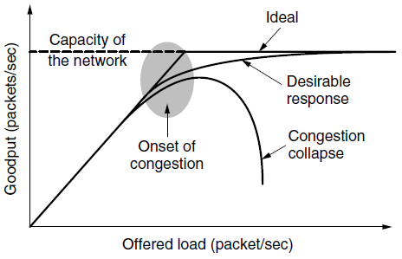
Congestion
When too much traffic is offered, congestion sets in and performance degrades sharply.

Slide 4
General Principles of Congestion Control
Monitor the system
  detect when and where congestion occurs.
Pass information to where action can be taken.
Adjust system operation to correct the problem.
Difference between Congestion control and flow control – Elaborate
Problem of infinite buffer - Elaborate

Slide 5
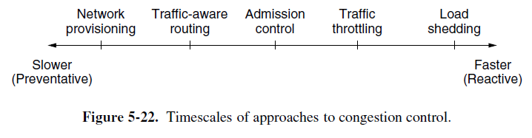
Approaches to Congestion Control
Two solutions possible:
Increase resources
Decrease load
Admission control in virtual networks – no more provisioning

Slide 6
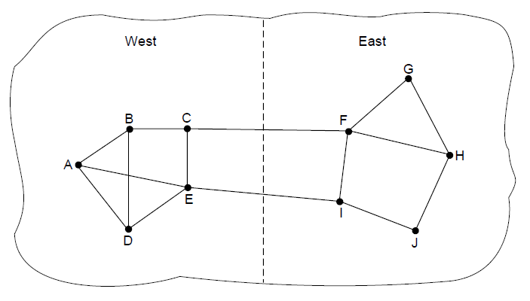
Traffic-Aware Routing
A network in which the East and West parts
are connected by two links.

Slide 7
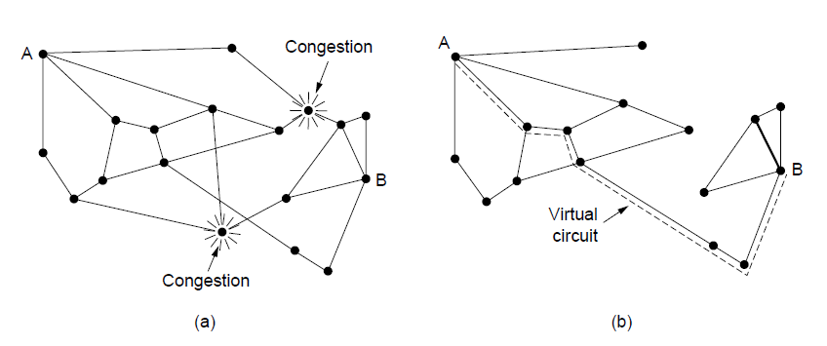
Admission Control
A congested network. (b) The portion of the network that is not congested. A virtual circuit from A to B is also shown.
Problem is in virtual circuits – there may be provisioning but not real usage.

Slide 8
Traffic Throttling:Congestion Detection
Routers must determine when congestion is approaching, ideally before it has arrived.
Each router can continuously monitor the resources it is using.
3 possibilities:
  1. utilization of the output links
  2. buffering of queued packets inside the router (most useful)
  3. no. of packets that are lost due to insufficient buffering
EWMA (Exponentially Weighted Moving Average)
d_{new} = αd_{old} + (1 − α)s,
where, the constant α determines how fast the router forgets recent history.
Whenever d moves above the threshold, the router notes the onset of congestion.

Slide 9
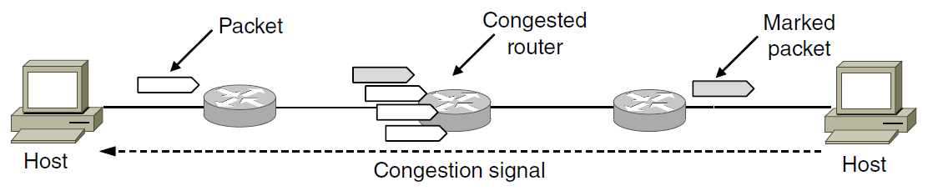
Traffic Throttling: Feedback
Routers must deliver timely feedback to the senders that are causing the congestion.
The router must identify the appropriate senders.
It must then warn them carefully, without sending many more packets into the already congested network.
Many feedback mechanisms:
Mechanism 1: Explicit Congestion Notification (ECN)

Slide 10
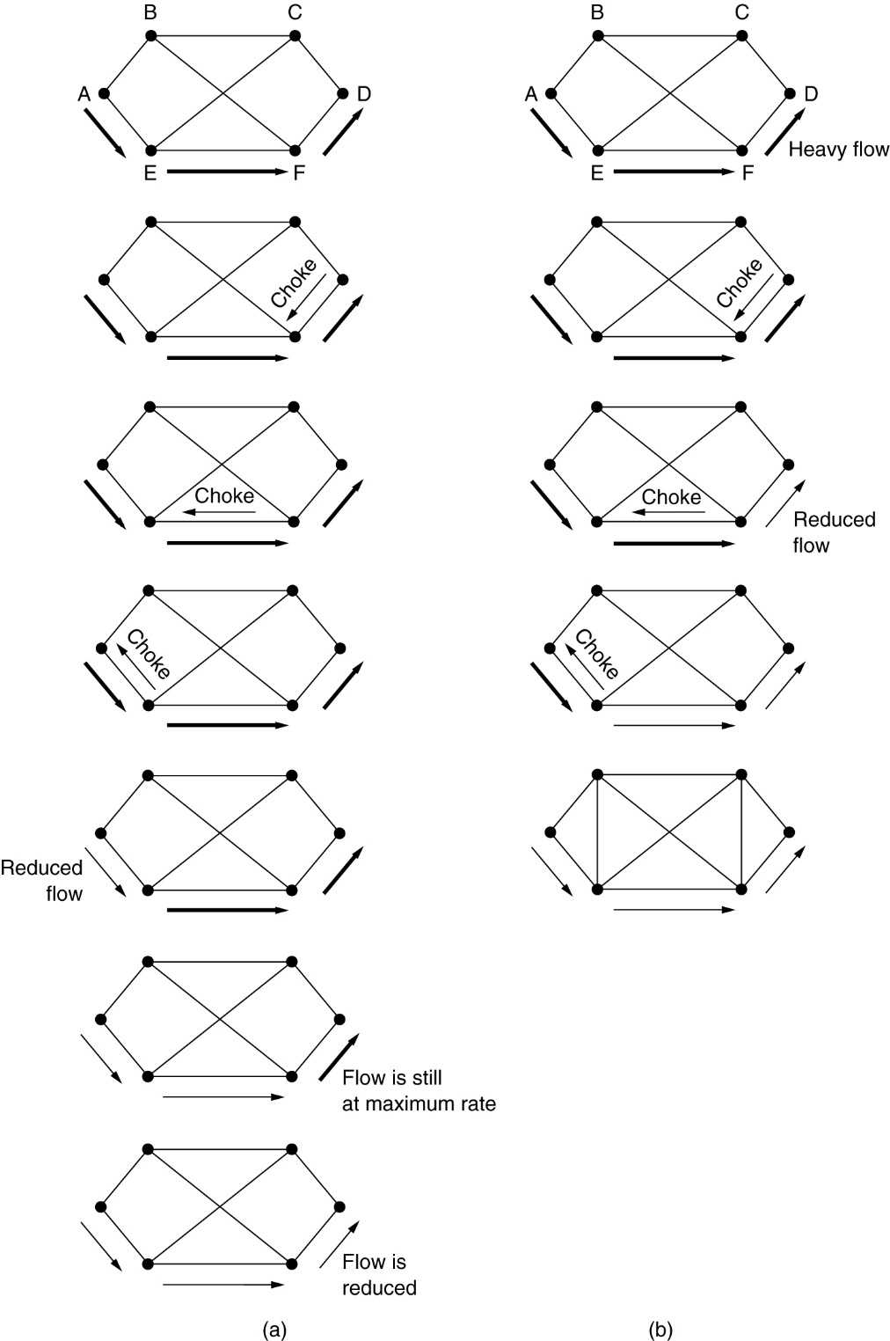
Mechanisms 2 & 3:
Direct Choke Packets,
Hop-by-Hop Backpressure
M-2: A choke packet that affects only the source.
M-3: A choke packet that affects each hop it passes through.
Sending choke packets to the source may be costly.

Slide 11
Mechanism 4: Load Shedding
Performed when all other strategies fail.
Cause blackout in some areas to save the entire network from failing.
Intelligent packet drop policy desired.
Which packets to discard may depend on application
Multimedia – old packets (full frame not to be discarded)
Text – Recent Packets
Packet’s importance can be marked in the beginning (application layer), then decision on which packets to discard can be taken.

Slide 12
Mechanism 5: Random Early Detection
Discard packets before all the buffer space is really exhausted.
To determine when to start discarding, routers maintain a running average of their queue lengths.
When average queue length exceeds a threshold, the link is said to be congested – small fraction of packets dropped at random.
The affected sender will notice the loss when there is no acknowledgement – transport protocol slowed down.

Slide 13
Quality of Service
Requirements
  Minimum throughput and maximum latency
Techniques for Achieving Good Quality of Service
Integrated Services
Differentiated Services
Label Switching and MPLS

Slide 14
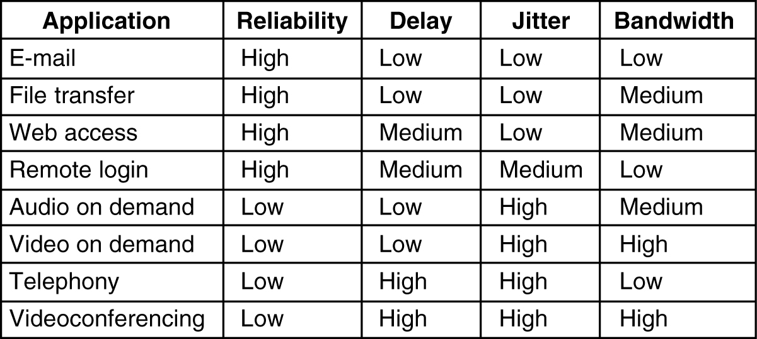
Requirements
5-30
How stringent the quality-of-service requirements are.

Slide 15
Categories of QoS and Examples
Constant bit rate
  Telephony
Real-time variable bit rate
  Compressed videoconferencing
Non-real-time variable bit rate
  Watching a movie on demand
Available bit rate
  File transfer

Slide 16
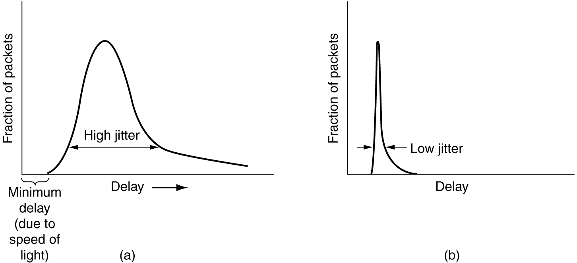
Jitter Control
Schedule Delay according to Deadline Miss
(a) High jitter. (b) Low jitter.

Slide 17
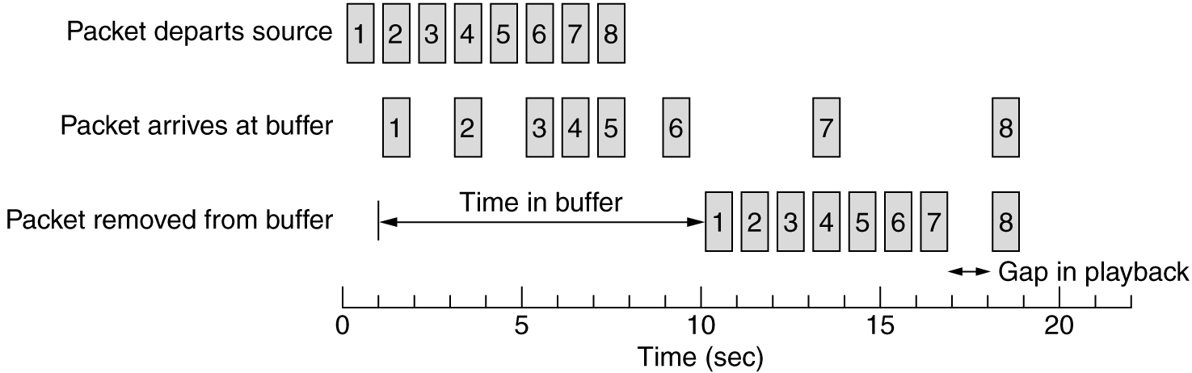
Buffering
Smoothing the output stream by buffering packets.

Slide 18
Traffic Shaping
Traffic in data networks is bursty – typically arrives at non-uniform rates as the traffic rate varies.
Traffic shaping is a technique for regulating the average rate and burstiness of a flow of data that enters the network.
When a flow is set up, the user and the network agree on a certain traffic pattern (shape).
Sometimes this agreement is called an SLA (Service Level Agreement).

Slide 19
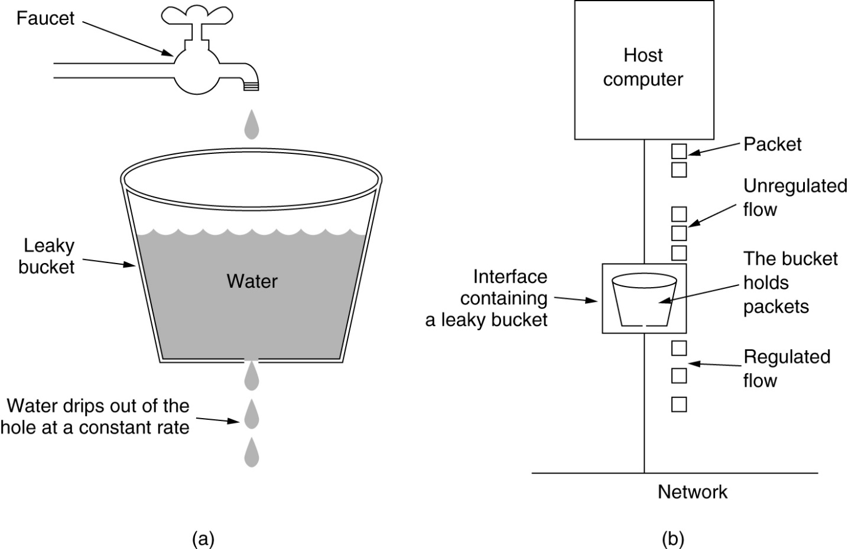
The Leaky Bucket Algorithm
(a) A leaky bucket with water. (b) a leaky bucket with packets.

Slide 20
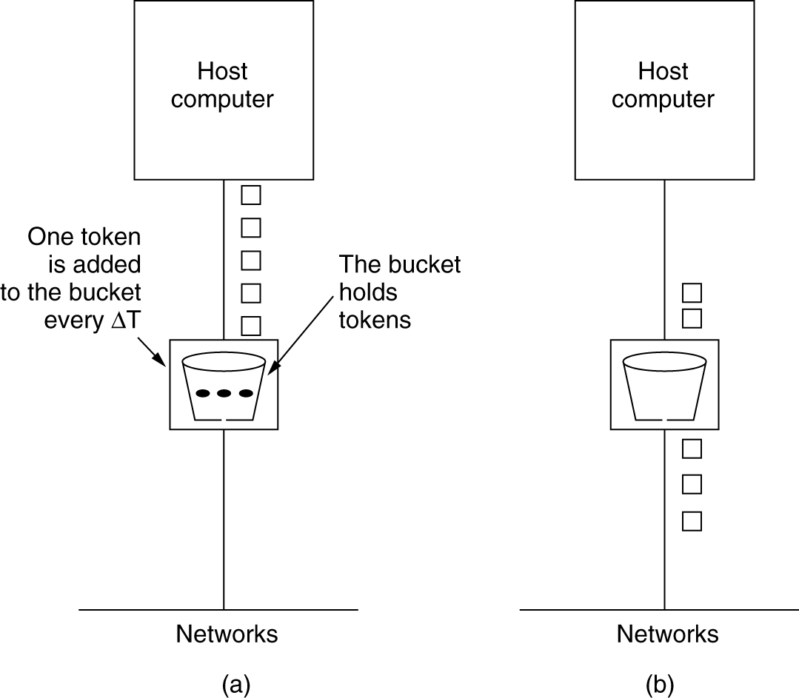
The Token Bucket Algorithm
5-34
(a) Before. (b) After.

Slide 21
Token Bucket Algorithm (2)
Burst length – S sec.
Maximum output rate – M bytes/sec
Token bucket capacity – B bytes
Token arrival rate – R bytes/sec
An output burst contains a maximum of (B + RS) bytes.
The number of bytes in a maximum speed burst of length S seconds is MS.
Hence, we have: B + RS = MS
This equation can be solved to get S = B /(M − R)

Slide 22
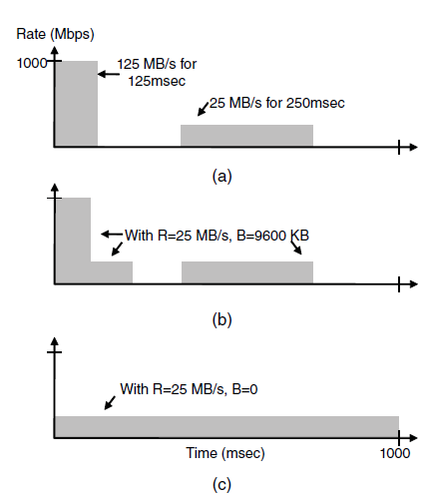
Traffic Shaping (2)
(a) Traffic from a host. Output shaped by a token bucket of rate 200 Mbps and capacity (b) 9600 KB, (c) 0 KB.

Slide 23
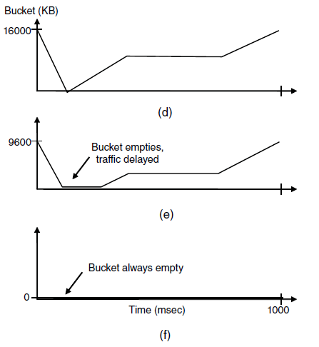
Traffic Shaping (3)
Token bucket level for shaping with rate 200 Mbps and capacity (d) 16000 KB, (e) 9600 KB, and (f) 0KB..

Slide 24
Packet Scheduling
Kinds of resources that can potentially be reserved for different flows:
Bandwidth.
Buffer space.
CPU cycles.

Slide 25
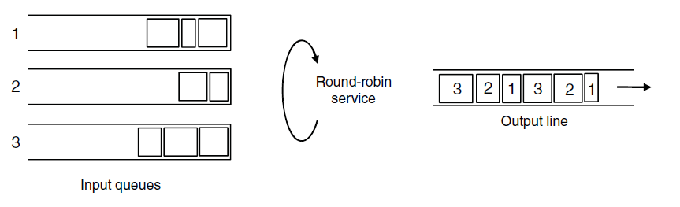
Packet Scheduling (2)
Round-robin Fair Queuing

Slide 26
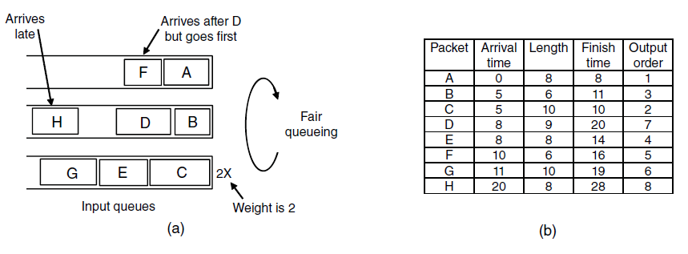
Packet Scheduling (3)
Weighted Fair Queueing.
Finishing times for the packets.

Slide 27
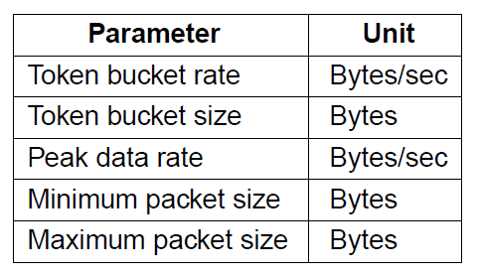
Admission Control (1)
An example flow specification

Slide 28
T = 1/\mu X 1/(1-\lambda/\mu) -- \lambda = 0.95Mpackets/sec
\mu = 1Mb packets/sec

Slide 29
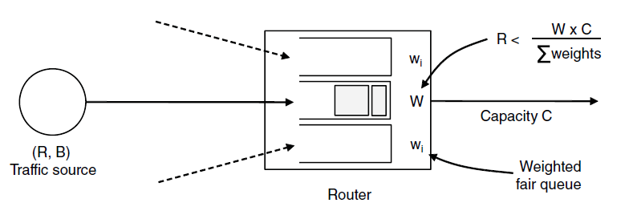
Admission Control (2)
Bandwidth and delay guarantees with token buckets and WFQ.

Slide 30
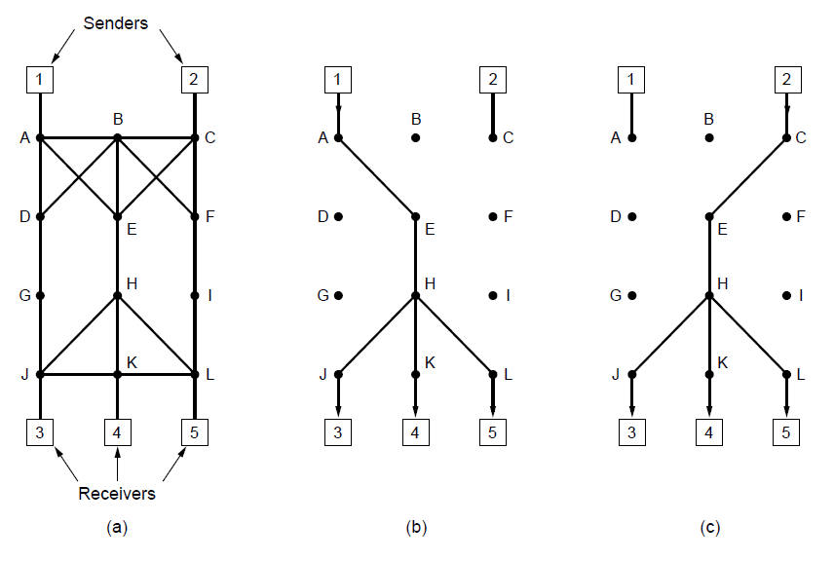
Integrated Services:
RSVP—The Resource reSerVation Protocol
(a) A network. (b) The multicast spanning tree for host 1.
(c) The multicast spanning tree for host 2.

Slide 31
Hosts 1 and 2 are multicast sender
3,4, 5 are multicast receiver
Host 3 reserves for Host 1 and the Host 2
Host 5 reserves Host 1 (so the common path is utilized). However depending on need (Host 5 may be a bigger TV) – provision is made for the greediest part

Slide 32
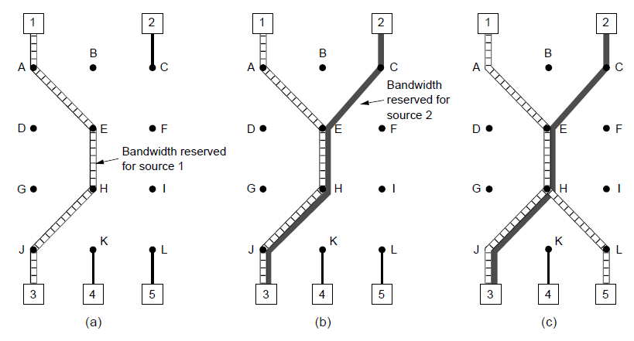
RSVP (2)
(a) Host 3 requests a channel to host 1. (b) Host 3 then requests a second channel, to host 2.
(c) Host 5 requests a channel to host 1.

Slide 33
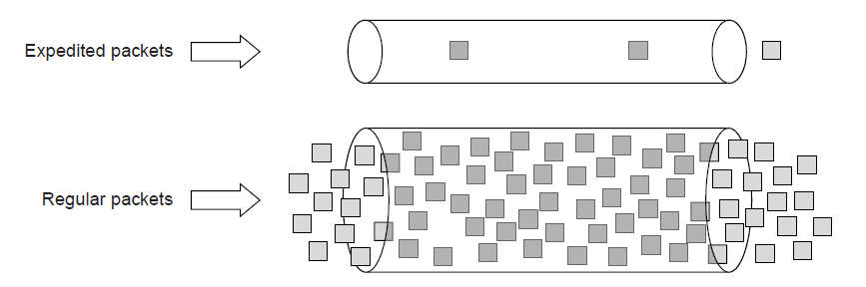
Differentiated Services:
Expedited Forwarding
Expedited packets experience a traffic-free network

Slide 34
Class-Based Service
Per Hop Behaviors
Traffic within a class are given preferential treatment
Expedited Forwarding
Packets marked – Regular or Expedited
Assured Forwarding
Gold, Silver, Bronze, common
Packets that face congestion
low (short burst), medium and high _ this classes are determined by tocken bucket algorithm

Slide 35
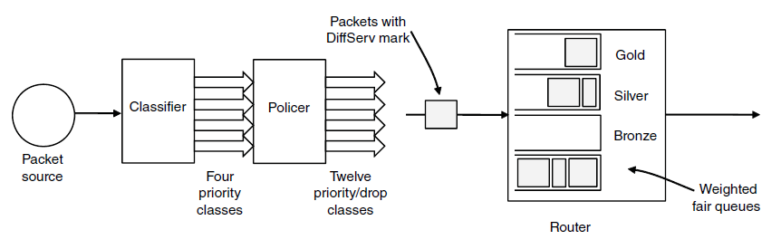
Differentiated Services:
Assured Forwarding
A possible implementation of assured forwarding, weighted fair scheduling, RED (randome Early Detection discards packet according to the class).

Slide 36
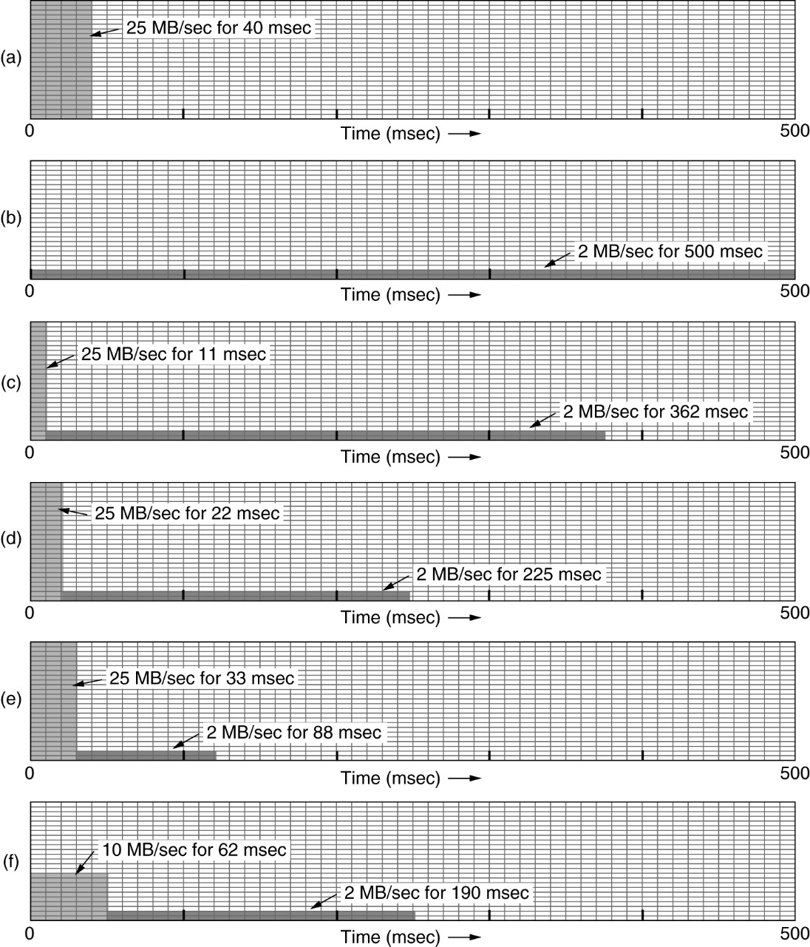
The Leaky Bucket Algorithm
(a) Input to a leaky bucket. (b) Output from a leaky bucket. Output from a token bucket with capacities of (c) 250 KB, (d) 500 KB, (e) 750 KB, (f) Output from a 500KB token bucket feeding a 10-MB/sec leaky bucket.

